Slide 1
Metrics Analysis and Forecasting
Reliable Forecasting Agile Teams and Projects
Troy Magennis

Slide 2
Turning Uncertainty into Risks
Outcomes are known.
This is the easiest way to make decisions. If I hold out my hand and drop a ball, it will fall to the ground.
Outcomes are unknown, but probabilities are known
This is risk. Think of this as going to Vegas and gambling. Before you set foot at the table, all of the outcomes are known as are the probabilities of each. No outcome surprises an objective third party.
Outcomes are unknown and probabilities are unknown
This is uncertainty.
http://www.farnamstreetblog.com/2013/11/decisions-under-uncertainty/

Slide 3
Goal: To forecast as well or better than the current methods at similar or less cost.

Slide 4
Know the problem you are answering
Forecasting an in-progress project / team
Forecasting a proposed project with(out) team
Forecasting whether project is “possible” by fixed date demanded
Forecasting the staff needs
Forecasting the biggest influencing factors
Forecasting the dollar impact of being late
Forecasting the impact of risks (biggest to smallest)

Slide 5
Strategies
Fix the solution and find the date
Dangerous territory, many un-stated assumptions
Fix the date and find the solution
Staffing solutions
Scope solutions (cut lines at various costs)
For both strategies –
State all assumptions required to hit the determined date and track
Constantly compare forecast against reality

Slide 6
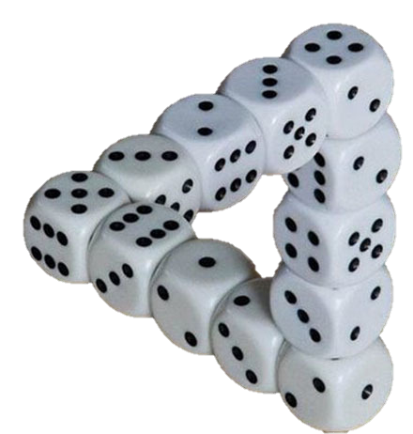
Forecasting Time Based
“Work”
“Rate” or “Pace”
“Concurrency”
or “Parallelism”

Slide 7
current forecasting practices
Why traditional forecasting practices fail to deliver and why this is the only outcome possible…

Slide 8
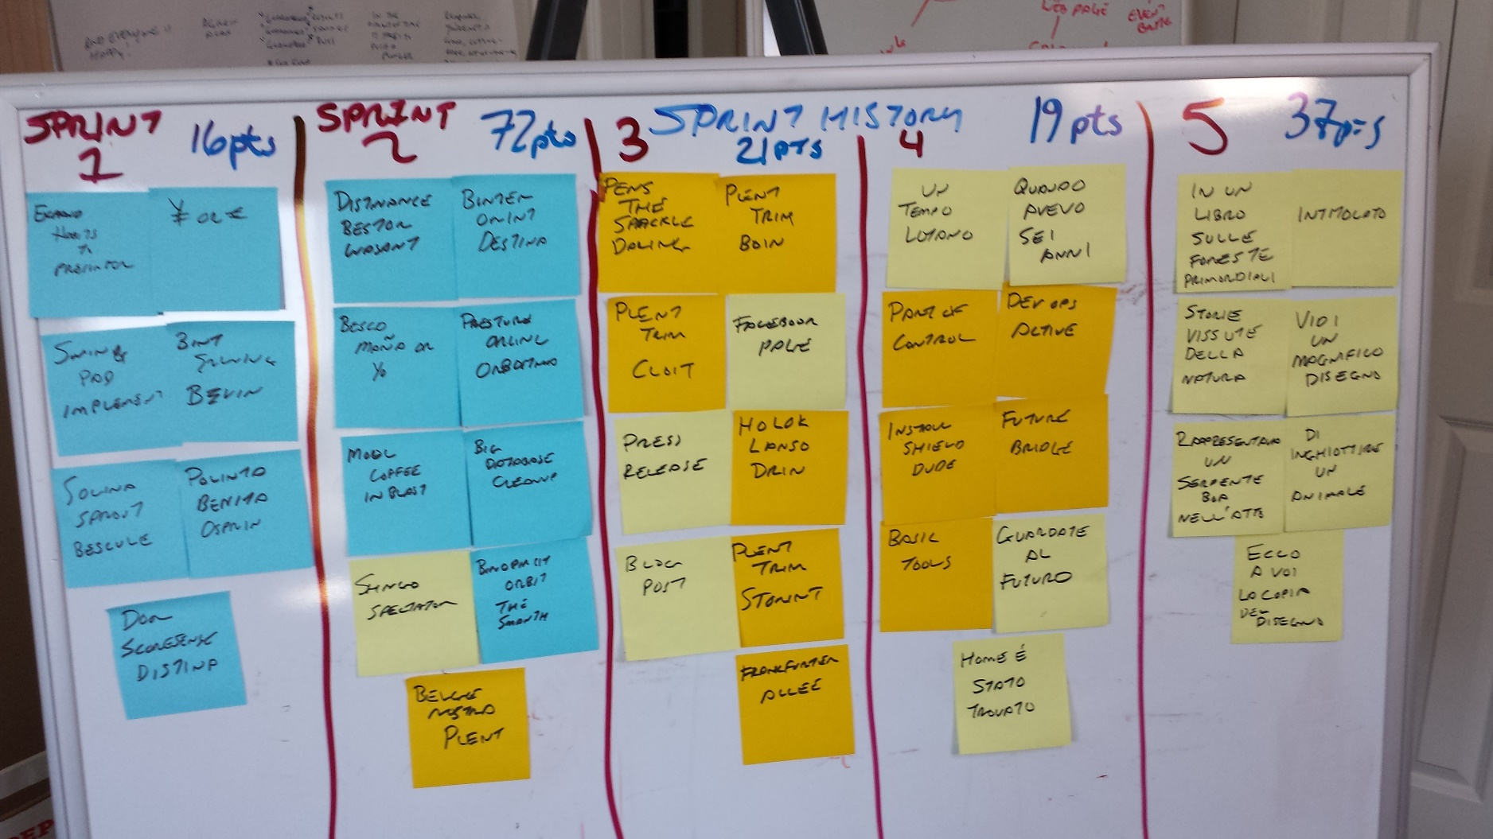
 | Sprint 1 | Sprint 2 | Sprint 3 | Sprint 4 | Sprint 5
Velocity | 16 pts | 72 pts | 21 pts | 19 pts | 37 pts
Throughput | 7 cards | 9 cards | 9 cards | 9 cards | 7 cards
Velocity: 16-72 pts, Throughput: 8 +/- 1
Source and with thanks: Jim Benson (Modus Cooperandi) http://moduscooperandi.com/blog/estimation-requires-attention/

Slide 9
Total Story Lead Time
30 days
Development Time 5 Days (~ 15%)
Blocked and Waiting Time 9 Days
Testing Time 2 Days
Waiting Time 3 Days
Defect Rework 2 Days
Waiting Time 8 Days
Release / DevOps Time 1 Day

Slide 10
Total Story Lead Time
30 days
Development Time 5 Days (~ 15%)
Blocked and Waiting Time 9 Days
Testing Time 2 Days
Waiting Time 3 Days
Defect Rework 2 Days
Waiting Time 8 Days
Release / DevOps Time 1 Day

Slide 11
Pre Work
30 days
Story / Feature Inception 5 Days
Waiting in Backlog 25 days
Total Story Lead Time
30 days
“Active Development” 30 days
Post Work 10 days
Waiting for Release Window 5 Days
System Regression Testing & Staging 5 Days

Slide 12
Pre Work
30 days
Story / Feature Inception 5 Days
Waiting in Backlog 25 days
Total Story Lead Time
30 days
“Active Development” 30 days
9 days (70 total) approx 13%
Post Work 10 days
Waiting for Release Window 5 Days
System Regression Testing & Staging 5 Days

Slide 13
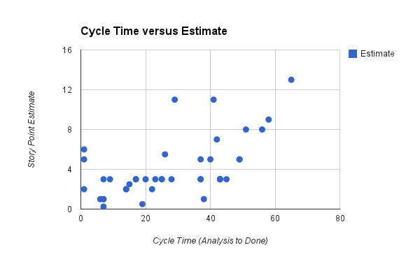

Slide 14
Trend-line forecasting

Slide 15
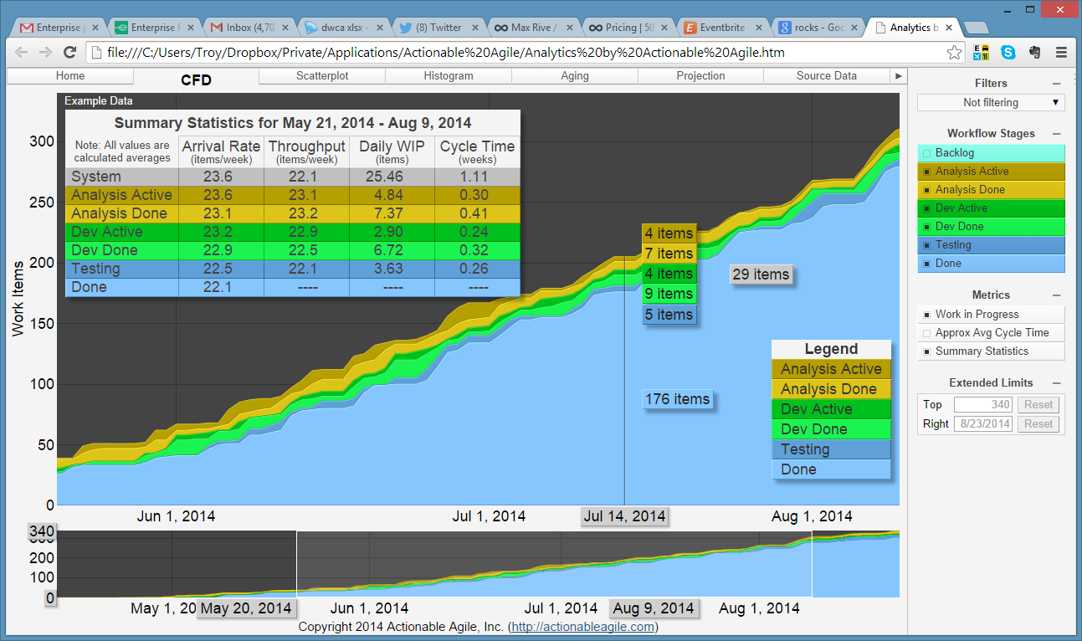
Card Status – Cumulative Flow
ActionableAgile.com – in beta now

Slide 16
Velocity vs Throughput
Both treat the system as a black box
Accurate as long as “context” stays the same
Points based velocity
Has to be cast to “time” unit
Non-linear scale issues
Throughput
Story count per week, already in time unit
Doesn’t require all work to be pre-estimated

Slide 17
Throughput Trend by Week

Slide 18
Throughput Trend by Week

Slide 19
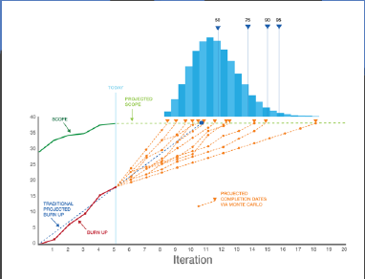
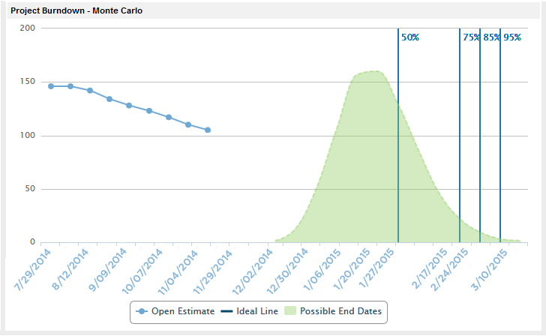
Throughput Tend-line Forecasting

Slide 20
Throughput
Use the historical rate of work completion
OK as a trend-line forecast
Not diagnostic, answers one question well: Time
Can be probabilistic
Context required
Backlog story count pre-split, throughput history post split
Throughput history may include non-project work
Defect counts add to the work and need to be corrected in a ratio form
Month has throughput trends due to events and vacation policies
Teams form and grow at different times of the throughput history.
Throughput trends follow patterns
Project ramp-up and down… S-Curve
Big - Small - Big - Etc.
Overtime and crunch modes pollute historical samples

Slide 21
Case study: estimating total story count
Do we have to break down EVERY epic to estimate story counts?

Slide 22
Problem: Getting a high level time and cost estimate for proposed business strategy
time and costs
Approach: Randomly sample epics from the 328 proposed and perform story breakdown. Then use throughput history to estimate time and costs

Slide 23
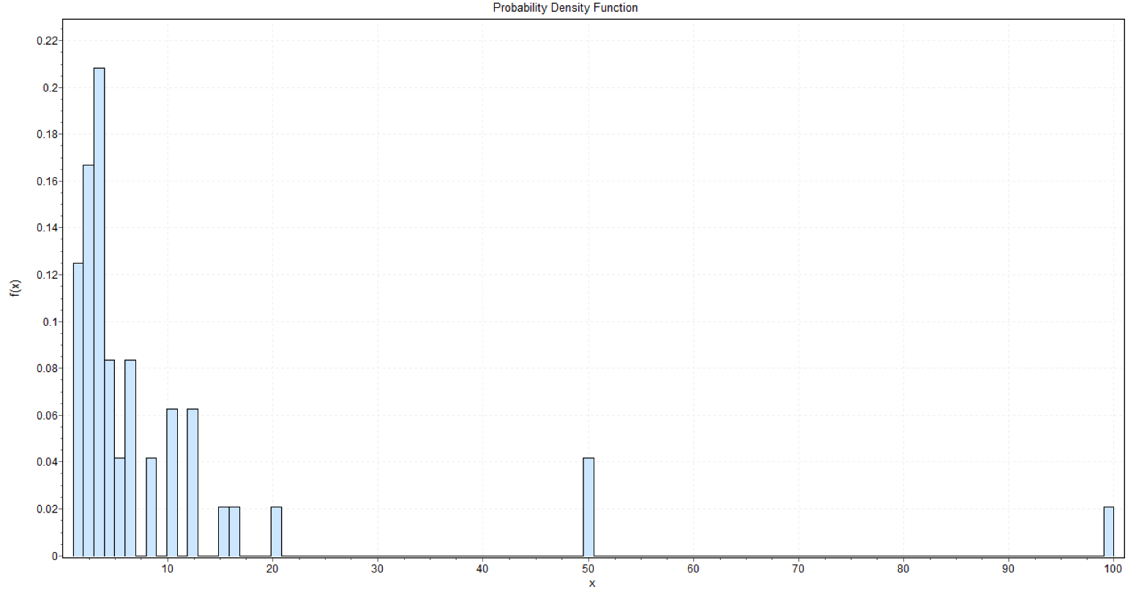
Understand outliers
Plot visually using Histogram
Set a rule: E.g. >10 times the mode? (state it)
Mode is 3
Projects in their own right. Estimated epics
50 & 100 are outliers worth discussion..

Slide 24

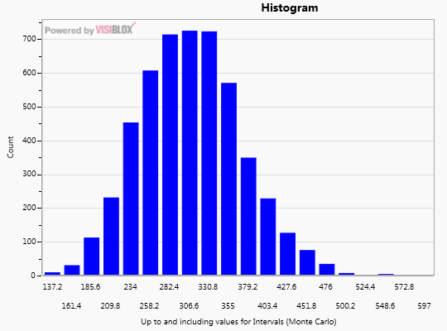
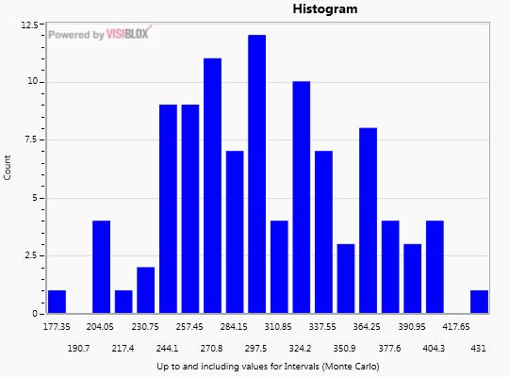
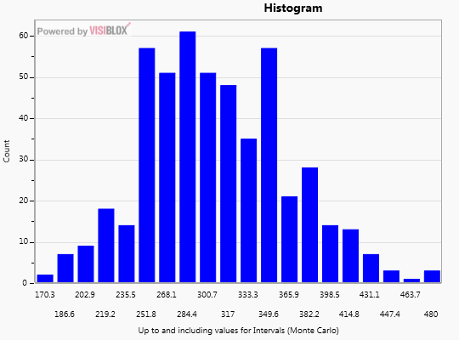
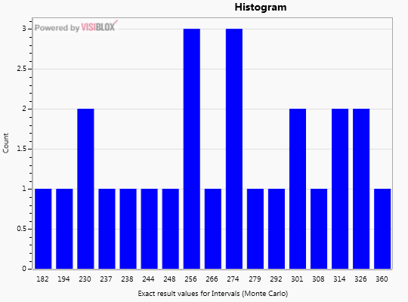
Sample with replacement
Remember to put the piece of paper back in after each draw!
Trial 1
Trial 2
Trial 100
9
1
35
9
4
19
35
13
7
5
13
13
5
13
14
11
11
5
5
Sum:
51
28
…
83
1
11
11
7
4
19
Number of stories

Slide 25
Epic Breakdown – Sample Count
Facilitated by well known consulting company, team performed story breakdown (counts) of epics.
48 (out of 328) epics were analyzed.
Actual Sum
262
Process | 50% CI | 75% CI | 95% CI
MC 48 samples | 261 | 282 | 315
Process | 50% CI | 75% CI | 95% CI
MC 48 samples | 261 | 282 | 315
MC 24 samples | 236 | 257 | 292
Process | 50% CI | 75% CI | 95% CI
MC 48 samples | 261 | 282 | 315
MC 24 samples | 236 | 257 | 292
MC 12 samples | 223 | 239 | 266
Process | 50% CI | 75% CI | 95% CI
MC 48 samples | 261 | 282 | 315
MC 24 samples | 236 | 257 | 292
MC 12 samples | 223 | 239 | 266
MC 6 samples | 232 | 247 | 268

Slide 26
Example: Spreadsheet Analysis

Slide 27
Case study: team throughput planning and forecasting

Slide 28
Problem: Teams unsure how to plan team constraints during cross-team planning. Teams spend considerable time estimating proposed work.
Approach: Give the teams a way to forecast throughput based on historical performance.

Slide 29
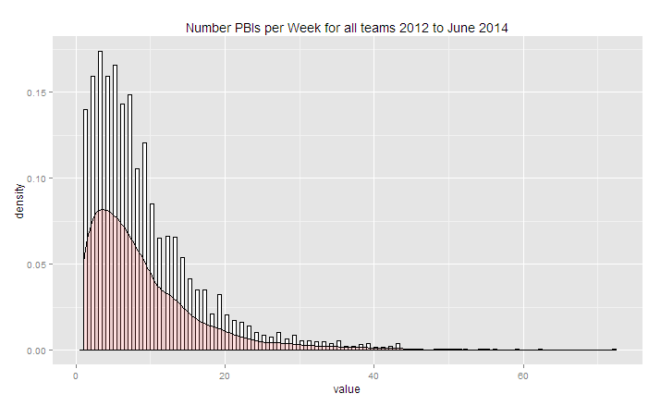
Completed items per week for 100+ teams (throughput)
Using the most recent 11-20 samples for forecasting
Evidence of data quality is well formed distribution shape

Slide 30
Example: Throughput Forecasting Tool (OK, its just a spreadsheet)

Slide 31
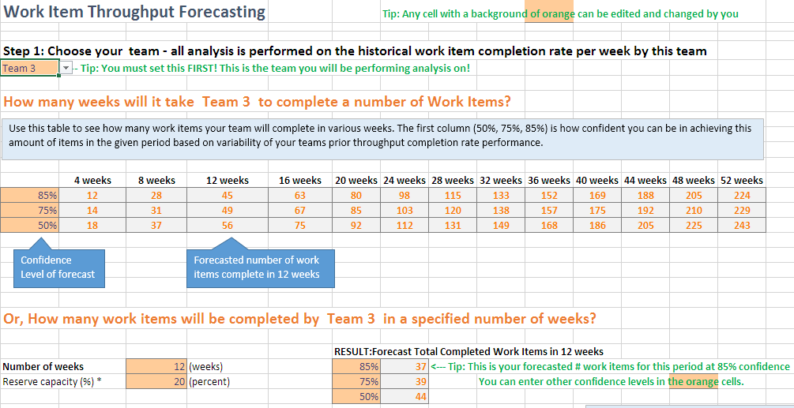

Slide 32
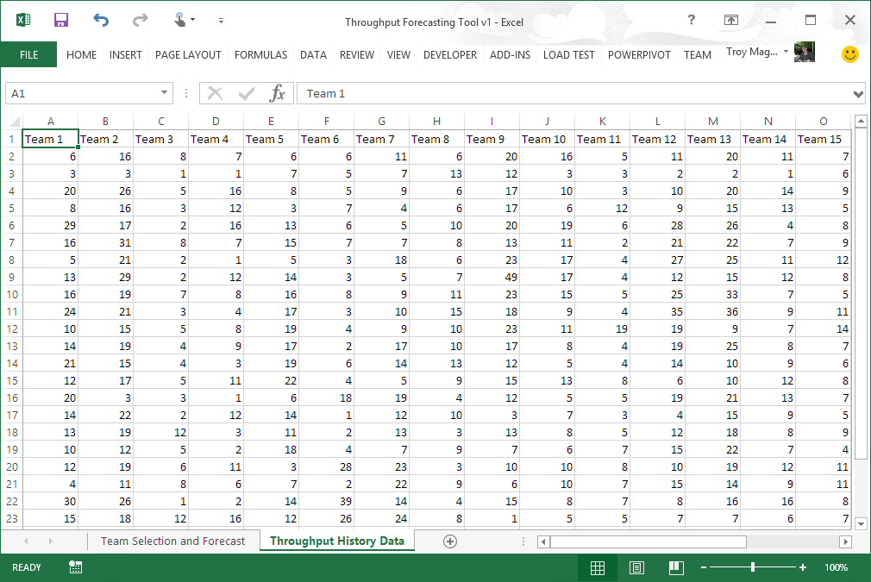

Slide 33
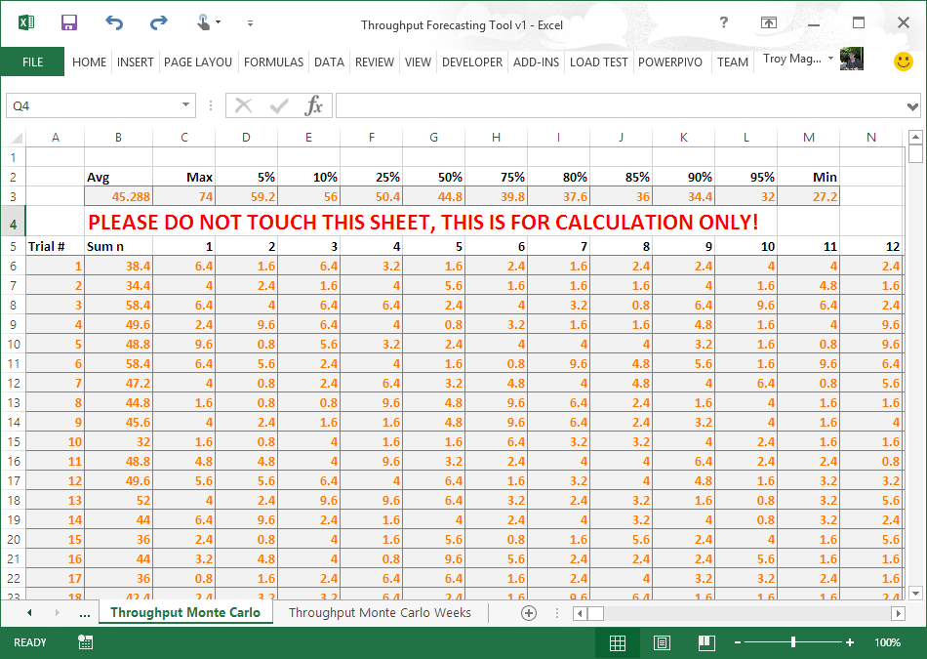

Slide 34
Dependency impact

Slide 35
What are the odds of a flawless sequential process?
?

Slide 36
Four people arrange a restaurant booking after work Q. What is the chance they arrive on-time to be seated?

Slide 37
Person 1 | Person 2 | Person 3 | Person 4

Slide 38
Person 1 | Person 2 | Person 3 | Person 4
1 in 16 EVERYONE is ON-TIME
15 TIMES more likely at least on person is late

Slide 39
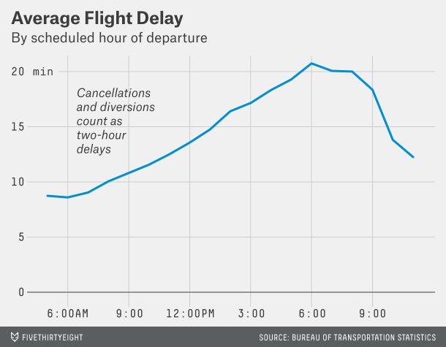

Slide 40

SEA to SFO (2 hours)
2 hours
SFO to JFK (6 hours)
1 hour un-board/board
6 hours
JFK to SFO (6 hours)
1 hour un-board/board
SFO to SEA (2 hours)
6 hours
1 hour un-board/board
2 hours

Slide 41
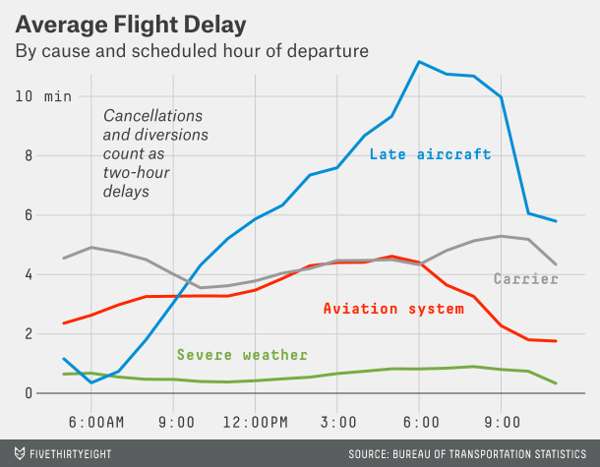

Slide 42
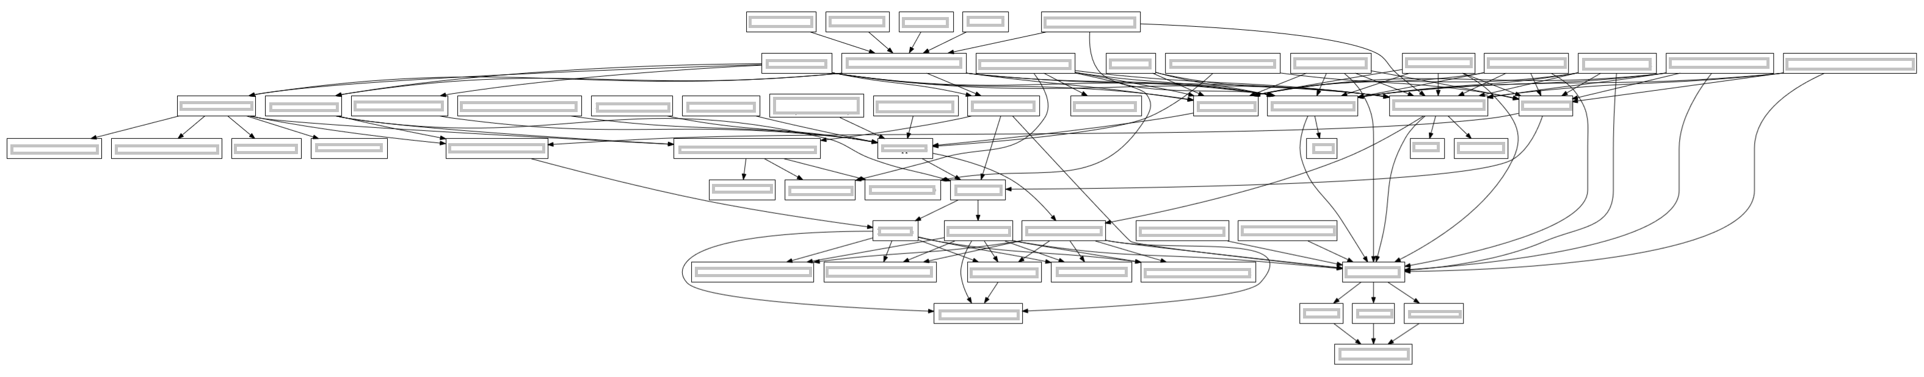
1
2
3
4
5
6
7
Team Dependency Diagram

Slide 43
1 in 2^{n} ^{or}
1 in 2⁷
^{or}
1 in 128

Slide 44
7 dependencies
1 chance in 128

Slide 45
6 dependencies
1 chance in 64

Slide 46
5 dependencies
1 chance in 32

Slide 47
Probabilistic forecasting

Slide 48
Forecasting Myths
1. You need lots of data to forecast
2. Statistical forecasting requires complex mathematics
3. If we have no data we can’t statistically forecast
False, if we understand the behavior of a domain (cycle time for example) we can be confident with no initial data
False. Most uncertainty is reduced within the first few samples
False. Everything you see today uses nothing more than the + and / operations!

Slide 49
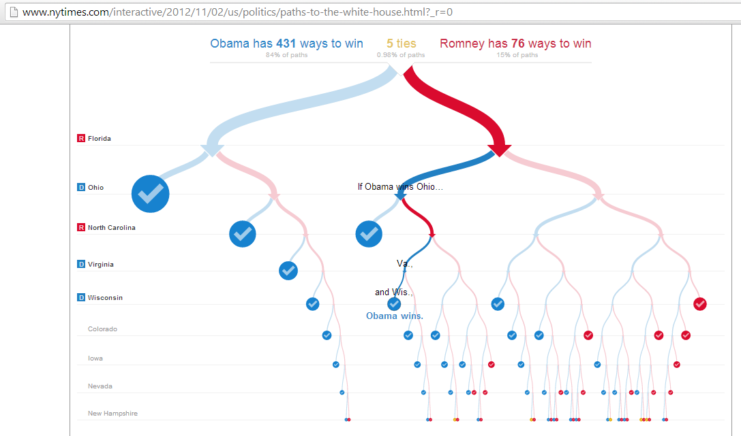
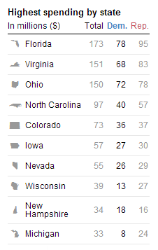

Slide 50
A model is a tool used to mimic a real world process
A tool for low-cost experimentation
Notes:
Models are tools for experimentation. They mimic a real world process or calculation and help you determine what the result might be given a set of input conditions. We normally get one chance to complete a software project, but using a model, we get to determine what the result might be given what we know today, and compare that with ideas we have for improvement.

Slide 51
Monte Carlo Simulation
Monte Carlo Simulation
Performing a simulation of a model multiple times using random input conditions and recording the frequency of each result occurrence
Notes:
When we say Monte Carlo simulation, what we are really saying is that we plot the result of a model by using random, but indicative input values. What we are doing is plotting what results are more likely than others, and how much more likely they are. It might seem obvious, but if we plotted the sum of two dice throws 100 times. Some combinations would occur more than others. Only one combination yields a 2 and 12, but many more yield 7. This likely hood of result helps us determine the odds (likelihood) of one value over another, and for software projects we can use the same technie for finding what delivery dates are more likely than other.

Slide 52

Scrum
Run | Sim Total Iterations
1 | 3
2 | 2
3 | 5
4 | 3
5 | 4
6 | 2
… | …
Backlog
This Iteration
Deployed
4
1
5
2
6
3
7
8
9
Notes:
For Scrum we might do this simply by taking a backlog of work estimated in story points and performing a burn-down regression. Rather than point estimates, we used ranges of story points for each story to show our uncertainty in story estimation, and during simulation we choose a random number between that range using a dice. We also pick at random the number of story points to be completed during each iteration, again between expert guessed ranges. By performing this multiple times and recording how many iterations it takes to complete, we can plot the odds of on date over others.

Slide 53
Kanban
Run | Time Total
1 | 5
2 | 4
3 | 3
4 | 9
5 | 5
6 | 6
… | …
Backlog
Design
Develop
Test
1 – 5 days
1 – 2 days
Deployed
1 – 2 days
1
2
3
Notes:
Kanban simulation would be similar. We move stories from backlog to complete through the columns our Kanban process defines using random cycle-times (within estimated ranges) for each card as it enters each column. We do this for the entire backlog and record the total number of days it takes to complete all work. We then do this hundreds of times. The outcome will be the odds of how many days it takes to complete the known work. Some results more common, some rarely encountered.

Slide 54
Result versus Frequency (50 runs)
More Often
25
20
15
Frequency of Result
10
5
1
10
15
20
Less Often
Result Values – For example, Days
Notes:
One graphic used to present the results of simulations like this is a Histogram. The result is shown on the X-Axis, days in this case, and the height of the blue bars indicates the number of times each result was encountered. The higher the bar the more common. Sfter 25 runs, a histogram might look like this.

Slide 55
Result versus Frequency (250 runs)
More Often
25
20
15
Frequency of Result
10
5
1
10
15
20
Less Often
Result Values – For example, Days
Notes:
But as more cycles are run, the graph starts to take a more definite shape.

Slide 56
Result versus Frequency (1000+ runs)
More Often
25
20
15
Frequency of Result
10
5
1
10
15
20
Less Often
Result Values – For example, Days
Notes:
Until approaching a very definite shape. Many processes build towards a bell-curve or Normal Distribution due to a process called the Law of Large Numbers and The Central Limit Theorem. Although this should not be assumed as we will discuss later in this talk.

Slide 57
Key Point
There is NO single forecast result
There will always be many
possible results, some more likely
Notes:
The key takeaway is that there is NEVER a single result from a process that takes multiple steps which have uncertainty and joins them together. Its not possible. There will always be a continuum of unlikely and more likely results.

Slide 58
50% Possible Outcomes
50% Possible Outcomes
Likelihood
Time to Complete Backlog
When pressed for a single number,
we often give the average.
Notes:
However, we are often pressed for a single date and look evasive when we try to convey our uncertainty. When we do this we often resort to stating not the lowest or the highest value, but the most likely or average value. The problem is by definition – we have the same odds as a coin toss as being right. 50% of the possible outcomes take longer, and this is often the reason for heroics and team morale destroying backlog re-estimation and grooming. By insisting on a single date to plan portfolio, the executives have actually chosen a 50% likelihood of hitting there financial forecasts, so it is in nobodies interest to give this number when pressed.

Slide 59
95% Outcomes
5%
Likelihood
Time to Complete Backlog
Monte Carlo Simulation Yields More Information – For example 95%
Notes:
One option is choosing a higher likelihood, say 95%. There will always be some outliers in a process. But the likelihoods of EVERYTHING taking the maximum estimate is very small, and by including those outcomes the end-date is so large tha no rational executive would fund a project. So, 95% is better, but good communication about uncertainty is better and we cover this later in the talk.

Slide 60
Key Point
“Average” is NEVER an option
WARNING: Regression lines are most often “average”
Notes:
The second key point is stating the Average value is destructive to all parties. A regression line on a burn-down or cumulative flow diagram is an Average, so it is a very poor practice.

Slide 61

But, I.T. gets worse
Notes:
Bu what I’m going to show you now shows that saying the odds were the same as a coin toss is being kind.

Slide 62
**Major risk events have the predominate role in deciding where deliver actually occurs **
We spend all our time estimating here
Plan
Performance Issues
External Vendor Delay
1
2
3

Slide 63
Risk likelihood changes constantly
95th Confidence Interval
1
2
3

Slide 64
Risk likelihood changes constantly
95th Confidence Interval
1
2
3

Slide 65
Risk likelihood changes constantly
95th Confidence Interval
1
2
3

Slide 66
Risk likelihood changes constantly
95th Confidence Interval
1
2
3

Slide 67


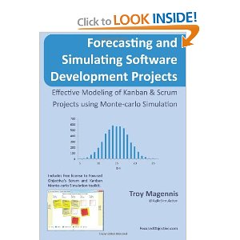



Notes:
The process described in this talk isn’t new. It has been used since the 1940’s and is commonplace in many risky fields. Here are some of the best books I’ve found that introduce the need and the process for employing modeling and simulation to forecast and manage risk. I only included my book in this esteemed list because it is focused on applying the techniques to agile software development, rather than discussing general methods. My suggested reading order would be: Flaw of Averages, How to Measure Anything and The Black Swan.

Slide 68
Simulation examples
Return to main presentation…

Slide 69
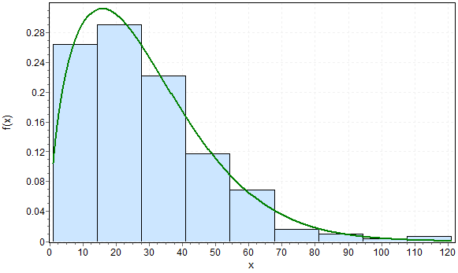
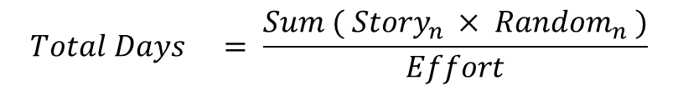
Historical Story Cycle Time Trend
Sum Random Numbers
25
11
29
43
34
26
31
45
22
27
31
43
65
45
8
7
34
73
54
48
19
12
24
27
21
3
9
20
23
29
More often
Less often
…..
Sum:
295
410
187
Basic Cycle Time Forecast Monte Carlo Process 1. Gather historical story lead-times 2. Build a set of random numbers based on pattern 3. Sum a random number for each remaining story to build a potential outcome
4. Repeat many times to find the likelihood (odds) to build a pattern of likelihood outcomes
$${Total Days}_{} = \frac{Sum ( {Story}_{n} × {Random}_{n} )}{Effort}$$
Days To Complete

Slide 70



1. Historical Cycle Time
Monte Carlo Analysis = Process to Combine Multiple Uncertain Measurements / Estimates
6. Phases
2. Planned Resources/ WIP
4. Historical Scope Creep Rate
3. The Work (Backlog)
Backlog
Feature 1
Feature 2
Feature 3
(optional)
5. Historical Defect Rate and Cycle Times
(optional)

Slide 71
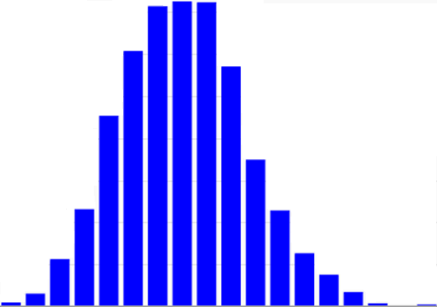
Cost to Develop
Planned / Due Date
Actual Date A
Actual Date B
Actual Date C
Staff A : $$$$$$$$
Staff B : $$
Staff C : $
Staff Option B
Staff Option A
Staff Option C
July
August
September
October
November
December
Forecast Completion Date

Slide 72
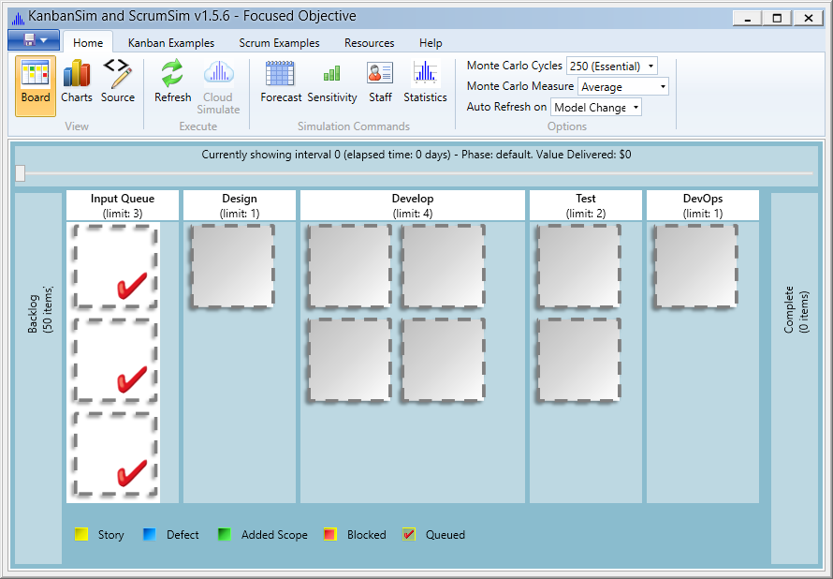
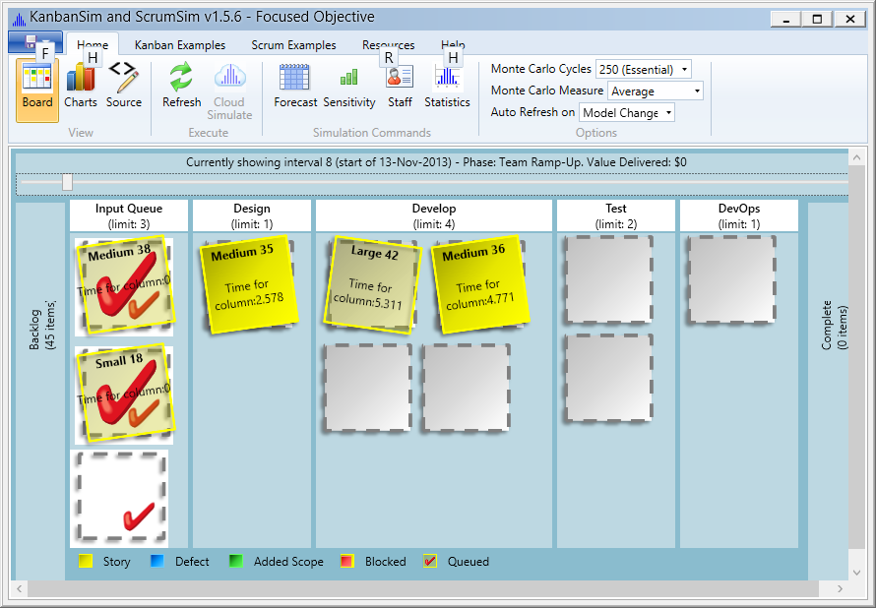
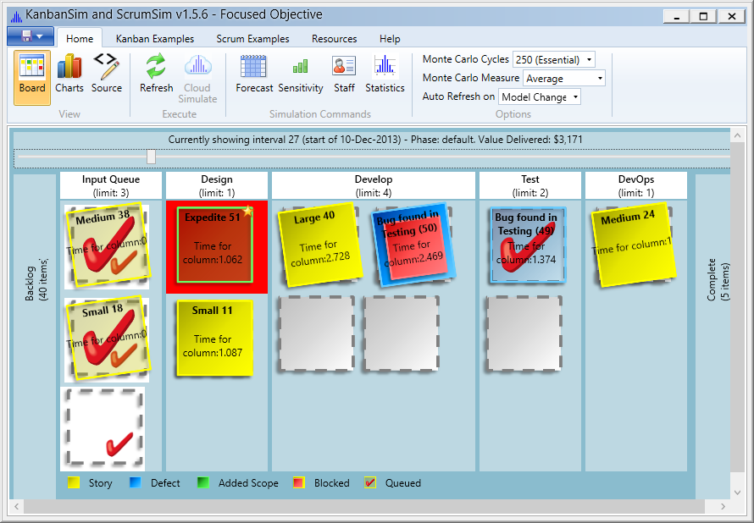
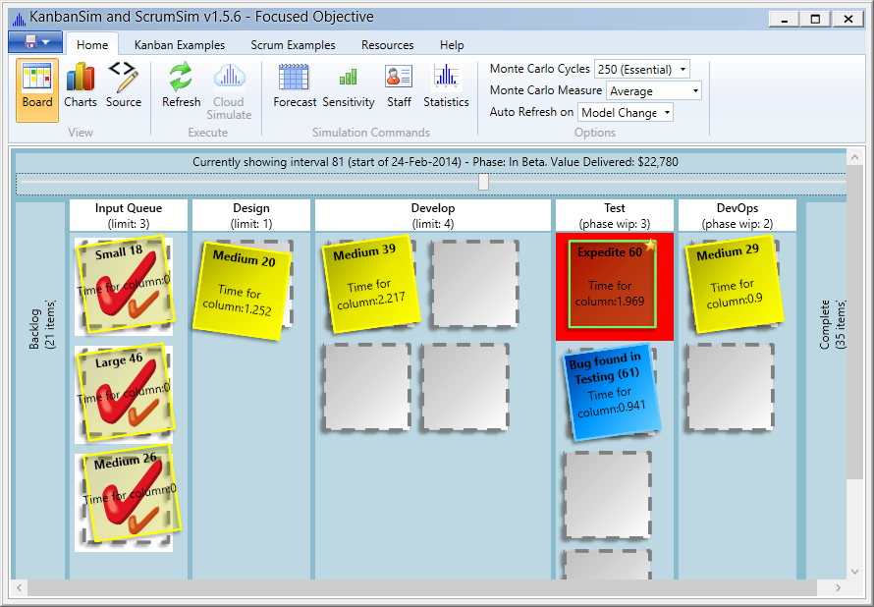

Slide 73
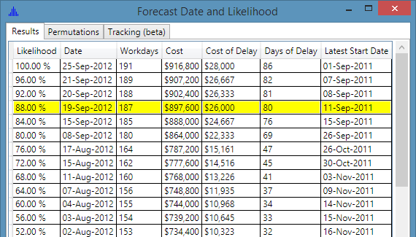
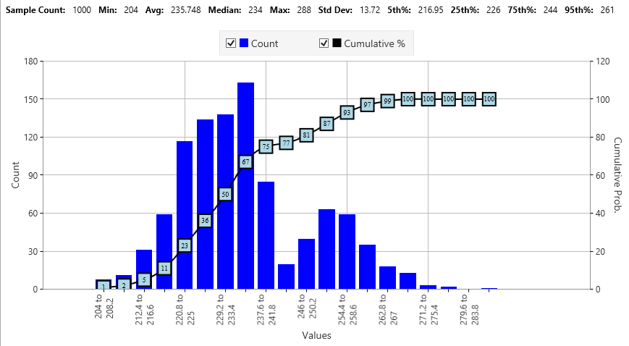
PS. ScrumSim and KanbanSim is free, focusedobjective.com

Slide 75
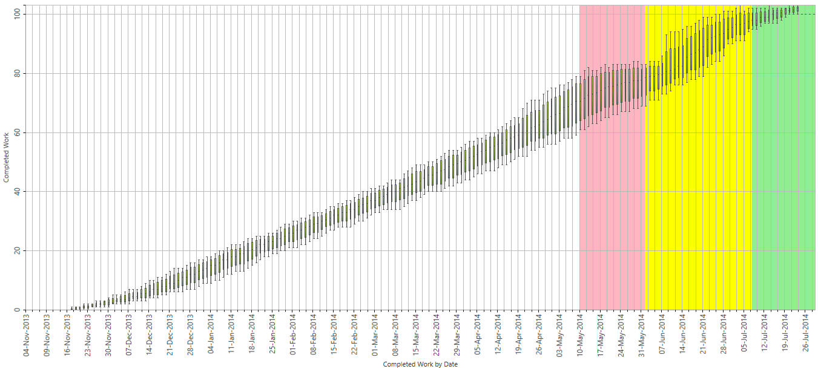
Y-Axis: Number of Completed Stories
Project Complete Likelihood
Range of complete stories probability
X-Axis: Date
0 to 50%
50 to 75%
>
75%

Slide 76
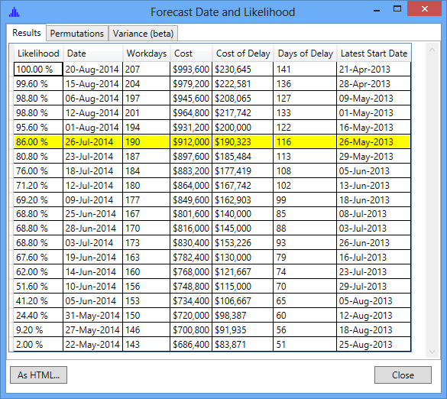
How certain based on model forecast
Further calculations to make economic tradeoffs

Slide 77
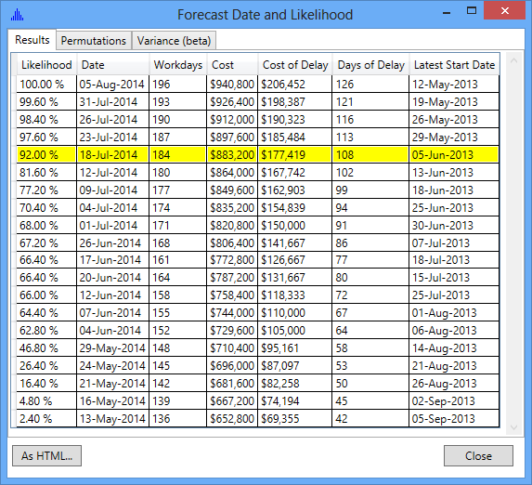
What is 10% Cycle Time Reduction Worth?
Baseline
Staff Cost
€912.000
Cost of Delay
€190.000
Total Cost
€1.102.000
+
=
Experiment: 10% Cycle Time Reduction
Staff Cost
€883.200
Cost of Delay
€177.419
Total Cost
€1.060.619
+
=
Opportunity: €41.381

Slide 78

1. Historical Cycle Time
Design
Develop
Test
A Process to Combine Multiple Uncertain Measurements / Estimates is Needed
Design
Develop
Test
2. Planned Resources/ Effort
4. Historical Scope Creep Rate
3. The Work (Backlog)
Backlog
Feature 1
Feature 2
Feature 3
(optional)
5. Historical Defect Rate & Cycle Times
(optional)

Slide 79
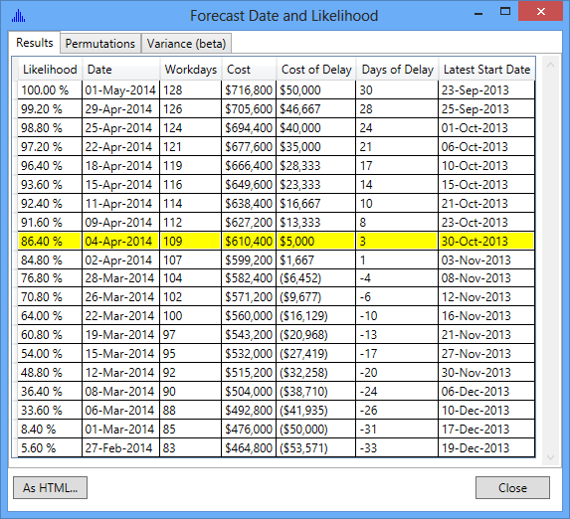
What is One Designer Worth?
Baseline
Staff Cost
€912.000
Cost of Delay
€190.000
Total Cost
€1.102.000
+
=
Experiment: + 1 Designer
Staff Cost
€610.400
Cost of Delay
€5.000
Total Cost
€615.400
+
=
Opportunity: €486.600

Slide 80
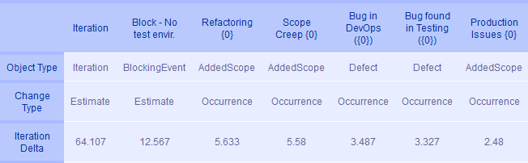
Sensitivity Report
Actively Manage
Ignore for the moment
Notes:
Forecasts and visual simulations are important, but what sets our product apart from tools that manage projects is our ability to highlight and list what factors cause the most impact to delivery date, cost and cycle-time.
This report shows what model factors have the most impact on the left, through to those that have marginal impact on the right. It makes sense that spending time on solving the root cause of a blocking event that is causing a 12 iteration impact is value for money, whilst the ones less than 3 iterations not so much.
A sensitivity report also helps you understand what needs to be modeled and estimated in greater detail. Nobody likes taking the smartest staff and locking them away to estimate new work, so it is important to only do this when those estimates will have a material impact on the final result. Sensitivity reporting should drive motivation and strategy to what estimates and data capturing tools are put in-place.
[click]

Slide 81
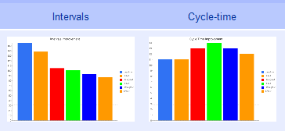
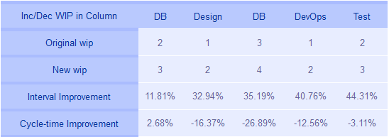
Staff Skill Impact Report
Explore what staff changes have the greatest impact
Notes:
Another specific sensitivity report that highlights what staff skills cause the most impact can be used to understand what the next hires should be. It can also show you the staff retention risk by detailing what staff member loss will cause the most impact to the team allowing you to manage that risk. Or conversely, another use of this report, and one we hope will be used infrequently is the ability to understand what staff reduction has the least impact.
This report shows the next 5 resources, and in what order, could reduce delivery time by 44%. However this decrease in delivery time
[click] comes at the expense of individual work cycle-time
[click], meaning that this report is the start of a discussion, not explicit hiring advice. All of the models and simulation reports provide the data for you to make decisions, but effective use is important.
[click]

Slide 82
Intuitive forecast uncertainty
How to understand model forecast uncertainty and direction

Slide 83
Sources of Forecast Uncertainty
Amount of Work
(# stories)
Cycle Time
Parallel
Work in Proc.
(WIP)
Random Chance / Risk

Slide 84
Good: Cycle Time Decreases (85^{th%})
Cycle time decreasing is generally good
Scatterplot gives the percentiles correctly
Model historical data should be refreshed
Policy: All data from current release if > 3 months history, else ALL of prior releases data
Warning signs –
Story count higher than modeled
Average WIP lower than modeled
Future work anticipated harder or riskier than prior work to date
Decrease NOT shared across all columns, E.g. Dev shows cycle time decrease, Test shows no decrease.

Slide 85
Good: Average WIP Increasing
Models assume a parallel amount of work actively being worked
CFD’s help measure the average WIP
Model Staff to WIP limit rations need to be refreshed
Warning signs –
Staff to WIP ratio not correct
Fewer staff than modeled
Story count higher than modeled
Cycle Time longer than modeled
Increase average WIP NOT shared across all columns.

Slide 86
Good: Story Count and Added Scope Rates Decreasing (or stable)
Models assume an amount of work to be completed
Tool tracks story counts per feature
Some models accounted for scope creep
Story counts need to be updated, and added scope reduced as actual data is available
Warning signs –
Average active WIP lower than modeled
Cycle time 85th % increasing from initial modeled historical data
Cycle time more right weighted

Slide 87
Forecast Trend Report Card
 | Watch | GREAT | Watch | Ok | Bad | Watch | WORRY | Watch
Cycle Time Trend versus Model | ↘ | ↘ | ↗ | ↗ | ↘ | ↘ | ↗ | ↗
ACTIVE WIP Actual vs Model | ↘ | ↗ | ↘ | ↗ | ↘ | ↗ | ↘ | ↗
Story Count Trend versus Model | ↘ | ↘ | ↘ | ↘ | ↗ | ↗ | ↗ | ↗
Arrow Legend: Green: Heading in beneficial direction Red: Heading in damaging direction
For “Watch” – the WIP and story count trends need to be analyzed. They are 1:1 ratio of compensating importance, and may offset each other.

Slide 88
Forecast Trend Report Card
 | Last Review | This Review | Actions
Cycle Time Trend | →↗↘ | →↗↘
Avg. WIP Actual vs Model | →↗↘ | →↗↘
Story Count Trend | →↗↘ | →↗↘
Future Feature Difficulty vs Prior | →↗↘ | →↗↘

Slide 89
If we understand how cycle time is statistically distributed, then an initial guess of maximum allows an accurate inference to be made
Alternatives -
Borrow a similar project’s data
Borrow industry data
Fake it until you make it… (AKA guess range)

Slide 90


1997: Industrial Strength Software
by Lawrence H. Putnam , IEEE , Ware Myers
2002: Metrics and Models in Software Quality Engineering (2nd Edition) [Hardcover]
Stephen H. Kan (Author)

Slide 91
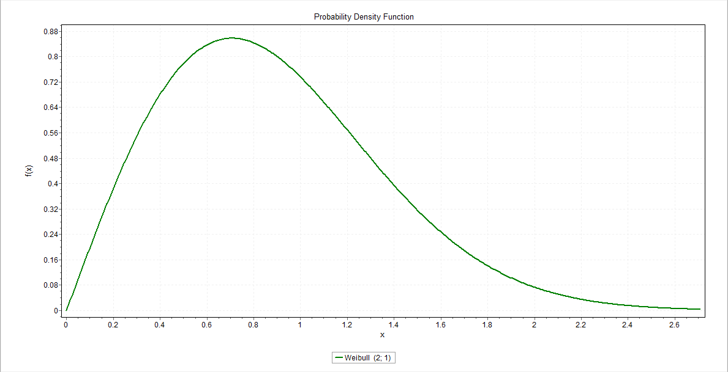
Waterfall
Weibull Shape Parameter = 2
AKA Rayleigh

Slide 92
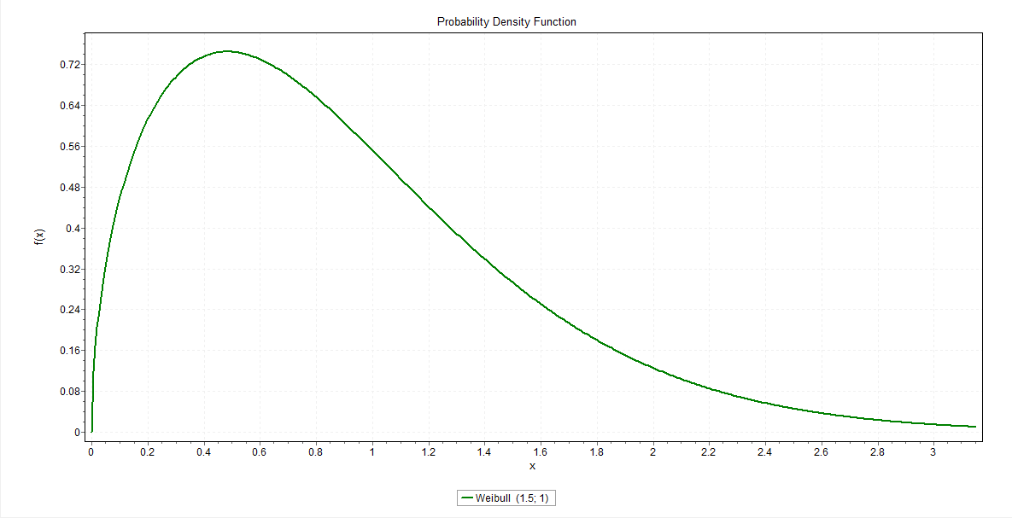
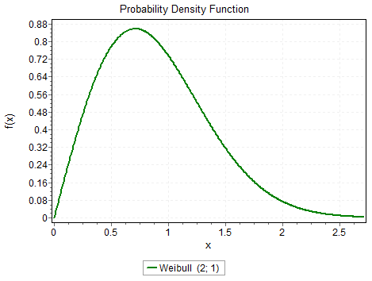
Agile (Scrum & Lean)
Weibull Shape Parameter = 1.5

Slide 93
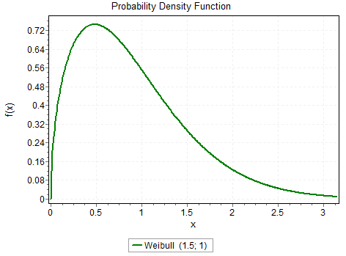
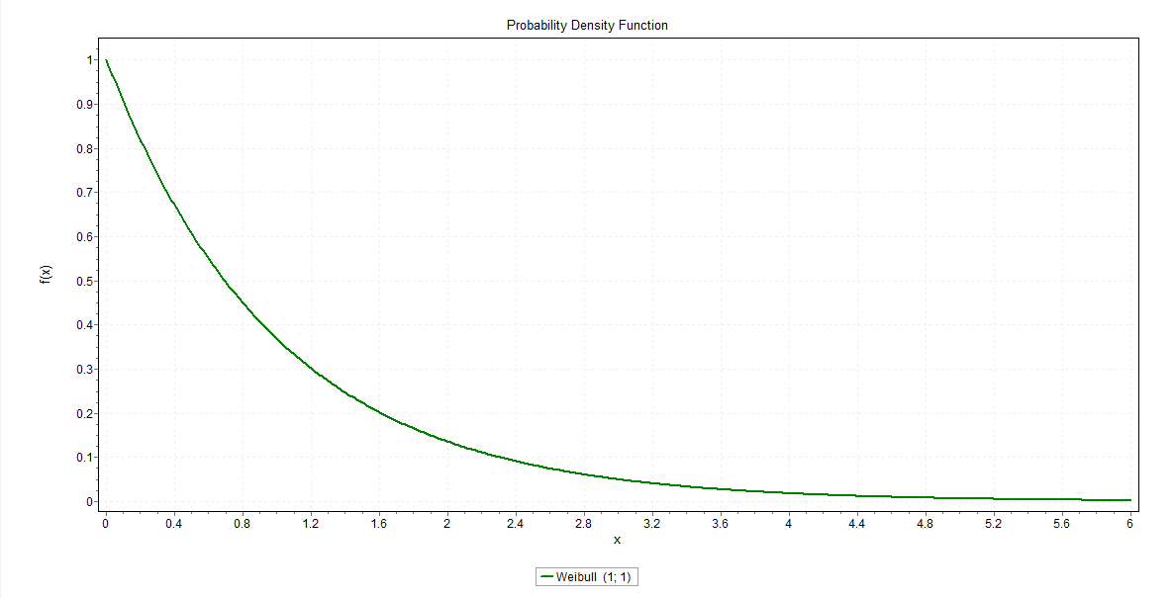
Typical Operations / Release
Weibull Shape Parameter = 1
AKA Exponential

Slide 94
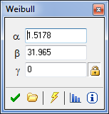
Shape – How Fat the distribution. 1.5 is a good starting point.
Scale – How Wide in Range. Related to the Upper Bound. *Rough* Guess: (High – Low) / 4
Location – The Lower Bound

Slide 95
What Distribution To Use...
No Data at All, or Less than < 11 Samples (why 11?)
Uniform Range with Boundaries Guessed (safest)
Weibull Range with Boundaries Guessed (likely)
11 to 30 Samples
Uniform Range with Boundaries at 5th and 95th CI
Weibull Range with Boundaries at 5th and 95th CI
More than 30 Samples
Use historical data as bootstrap reference
Curve Fitting software

Slide 96
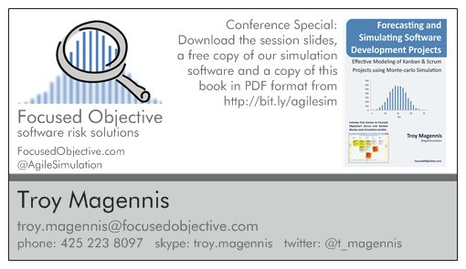

Slide 97
Contact Details
www.FocusedObjective.com
Download latest software, videos, presentations and articles on forecasting and applied predictive analytics
Troy.Magennis@focusedobjective.com
My email address for all questions and comments
@t_magennis
Twitter feed from Troy Magennis

Slide 98
reference

Slide 99
Correlation and Outliers
Outliers a major factor on correlation
Assume linear correlation, always scatterplot
Calculations
Pearson Correlation Co-efficient
Spearman’s Rank Order
If range is large, this is a good candidate
Least-squares Method
Vulnerable to extreme values

Slide 100
Context – Does History Repeat?
Internal differences in team skills
Any change (Hawthorn Effect)
Change of Risk Profile
Unstable WIP
Poor Quality
Unstable Test Environment
Seasons - Vacations
Executive Re-org
Natural Disasters
Exceptional Sickness
Changes in Staff
Team Changes
Location
Environmental Disturbance
Moral Shifts
Process Change
Architectural Change
Fatigue (Low Work Moral)
Added Scope
Change of demand for different classes of service
Account of Expedites
Changes in how to measure
Poor record keeping
Delivery frequency / cadence
Org changes / staffing
Gaming the System
Mergers and Acquisitions
Multi tasking
High attrition rates
Staff availability due to prod issues
Critical specialists not available
Introduce new technology
Technical architectural changes
Legal requirements (date fixed)
Beginning the project
User stories too large
Dependency identification
Technical complexity
External spot demands
Changing prioritization
Expedited work
External dependencies
Types of contract
Better coffee
Relevant training
Process changes
Process problem moving tickets
Policy changed
New management policy

Slide 101
Forecasting strategies

Slide 102
When you have historical data
1. Model Baseline using historically known truths
2. Test Model against historically known truths
3. Forecast
January
February
March
April
May
June
July
August
September
The Past
The Future

Slide 103
When you have no historical data
January
February
March
April
May
June
July
August
September
The Future

Slide 104
Capturing Cycle Time and WIP
Story | Start Date | Completed Date | Cycle Time (days)
1 | 1 Jan 2013 | 15 Jan 2013
2 | 5 Jan 2013 | 12 Jan 2013
3 | 5 Jan 2013
4 | 6 Jan 2013
5 | 3 Jan 2013 | 7 Jan 2013
6 | 7 Jan 2013 | 18 Feb 2013
7 | 10 Jan 2013 | 22 Jan 2013
8 | 10 Jan 2013 | 18 Jan 2013
9 | 13 Jan 2013 | 26 Jan 2013
10 | 15 Jan 2013
14
Date “Complete” – Date “Started”

Slide 105
Capturing Cycle Time and WIP
Story | Start Date | Completed Date | Cycle Time (days)
1 | 1 Jan 2013 | 15 Jan 2013
2 | 5 Jan 2013 | 12 Jan 2013
3 | 5 Jan 2013
4 | 6 Jan 2013
5 | 3 Jan 2013 | 7 Jan 2013
6 | 7 Jan 2013 | 18 Feb 2013
7 | 10 Jan 2013 | 22 Jan 2013
8 | 10 Jan 2013 | 18 Jan 2013
9 | 13 Jan 2013 | 26 Jan 2013
10 | 15 Jan 2013
Date | WIP
1 Jan
3 Jan
4 Jan
5 Jan
6 Jan
7 Jan
8 Jan
9 Jan
10 Jan
…
15 Jan
5
Count of Started, but Not completed work

Slide 106
Capturing Cycle Time and WIP
Story | Start Date | Completed Date | Cycle Time (days)
1 | 1 Jan 2013 | 15 Jan 2013 | 14
2 | 5 Jan 2013 | 12 Jan 2013 | 7
3 | 5 Jan 2013
4 | 6 Jan 2013
5 | 3 Jan 2013 | 7 Jan 2013 | 4
6 | 7 Jan 2013 | 18 Feb 2013 | 42
7 | 10 Jan 2013 | 22 Jan 2013 | 12
8 | 10 Jan 2013 | 18 Jan 2013 | 8
9 | 13 Jan 2013 | 26 Jan 2013 | 13
10 | 15 Jan 2013
Date | WIP
1 Jan | 1
3 Jan | 2
4 Jan | 2
5 Jan | 3
6 Jan | 4
7 Jan | 5
8 Jan | 5
9 Jan | 5
10 Jan | 7
… | …
15 Jan | 7

Slide 107
Cycle Time for Story/Epic =
Date “Complete” – Date “Started”
Work in Process at Date x =
Count of (“Started” < Date x
& “Completed” > Date x)
If you have a captured start and complete date you can calculate cycle time and WIP.
Note: Cycle time sometimes referred to as Lead Time but not going to discuss this now!

Slide 108
Trial 1
Trial 2
Trial 100
9
1
35
9
4
19
35
13
7
5
13
13
5
13
14
11
11
5
5
Sum:
51
28
…
83
1
11
11
7
4
19
By repetitively sample we build trial hypothetical “project” completions
Fancy term for turning a small set of samples into a larger set:
Bootstrapping

Slide 109
Goal:
Take many uncertain inputs and combine them to derive a forecast

Slide 110
Monte Carlo Forecasting involves taking a variety of uncertain inputs and finding what outcomes are possible, and what outcomes are more likely
50% Possible Outcomes
50% Possible Outcomes
Likelihood
Time to Complete Backlog

Slide 111
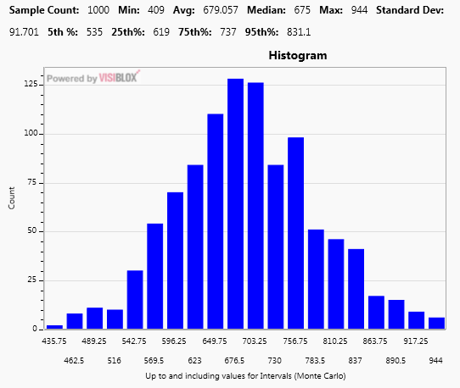
Can’t I just use Average Cycle Time?
 | Forecast (Days)
Median | 525
Mean | 670
MC >50% | 677
MC >85% | 793
MC >95% | 851
Projection of cycle time to complete 25 stories in a sequential fashion based upon historical cycle time data

Slide 112
Historical Story Lead Time Trend
Sum Random Numbers
25
11
29
43
34
26
31
45
22
27
31
43
65
45
8
7
34
73
54
48
19
12
24
27
21
3
9
20
23
29
…..
Sum:
295
410
187
Basic Cycle Time Forecast Monte Carlo Process 1. Gather historical story lead-times 2. Build a set of random numbers based on pattern 3. Sum a random number for each remaining story to build a single outcome
4. Repeat many times to find the likelihood (odds) to build a pattern of likelihood outcomes
$${Total Days}_{} = \frac{Sum ( {Story}_{n} × {Random}_{n} )}{Effort}$$
Days To Complete

Slide 113
Models Start with Assumptions
Cycle Time
Guessed
Last releases performance
Another teams performance
Amount of Work
# Stories guessed
Scope creep guessed
Similar sizing distribution to last release assumed
Concurrent WIP
Guessed
Measured from last release
Similar process to last release assumed

Slide 114
Models Need Updating with New Information When Available
Cycle Time
Actual data from this release
Amount of Work
Number Stories per Feature actuals
Scope Creep actuals
Cycle time distribution for this release
Concurrent WIP
Actual data from this release

Slide 115
Speaking Risk To Executives
Buy them a copy of “Flaw of Averages”
Show them you are tracking & managing risk
Do
“We are 95% certain of hitting date x”
“With 1 week of analysis, that may drop to date y”
“We identified risk x, y & z that we will track weekly”
Don’t
Give them a date without likelihood
“February 29th 2013”
Give them a date without risk factors considered
“To do the backlog of features, February 29th, 2013”

Slide 116
Context – Does History Repeat?
Internal differences in team skills
Any change (Hawthorn Effect)
Change of Risk Profile
Unstable WIP
Poor Quality
Unstable Test Environment
Seasons - Vacations
Executive Re-org
Natural Disasters
Exceptional Sickness
Changes in Staff
Team Changes
Location
Environmental Disturbance
Moral Shifts
Process Change
Architectural Change
Fatigue (Low Work Moral)
Added Scope
Change of demand for different classes of service
Account of Expedites
Changes in how to measure
Poor record keeping
Delivery frequency / cadence
Org changes / staffing
Gaming the System
Mergers and Acquisitions
Multi tasking
High attrition rates
Staff availability due to prod issues
Critical specialists not available
Introduce new technology
Technical architectural changes
Legal requirements (date fixed)
Beginning the project
User stories too large
Dependency identification
Technical complexity
External spot demands
Changing prioritization
Expedited work
External dependencies
Types of contract
Better coffee
Relevant training
Process changes
Process problem moving tickets
Policy changed
New management policy

Slide 118
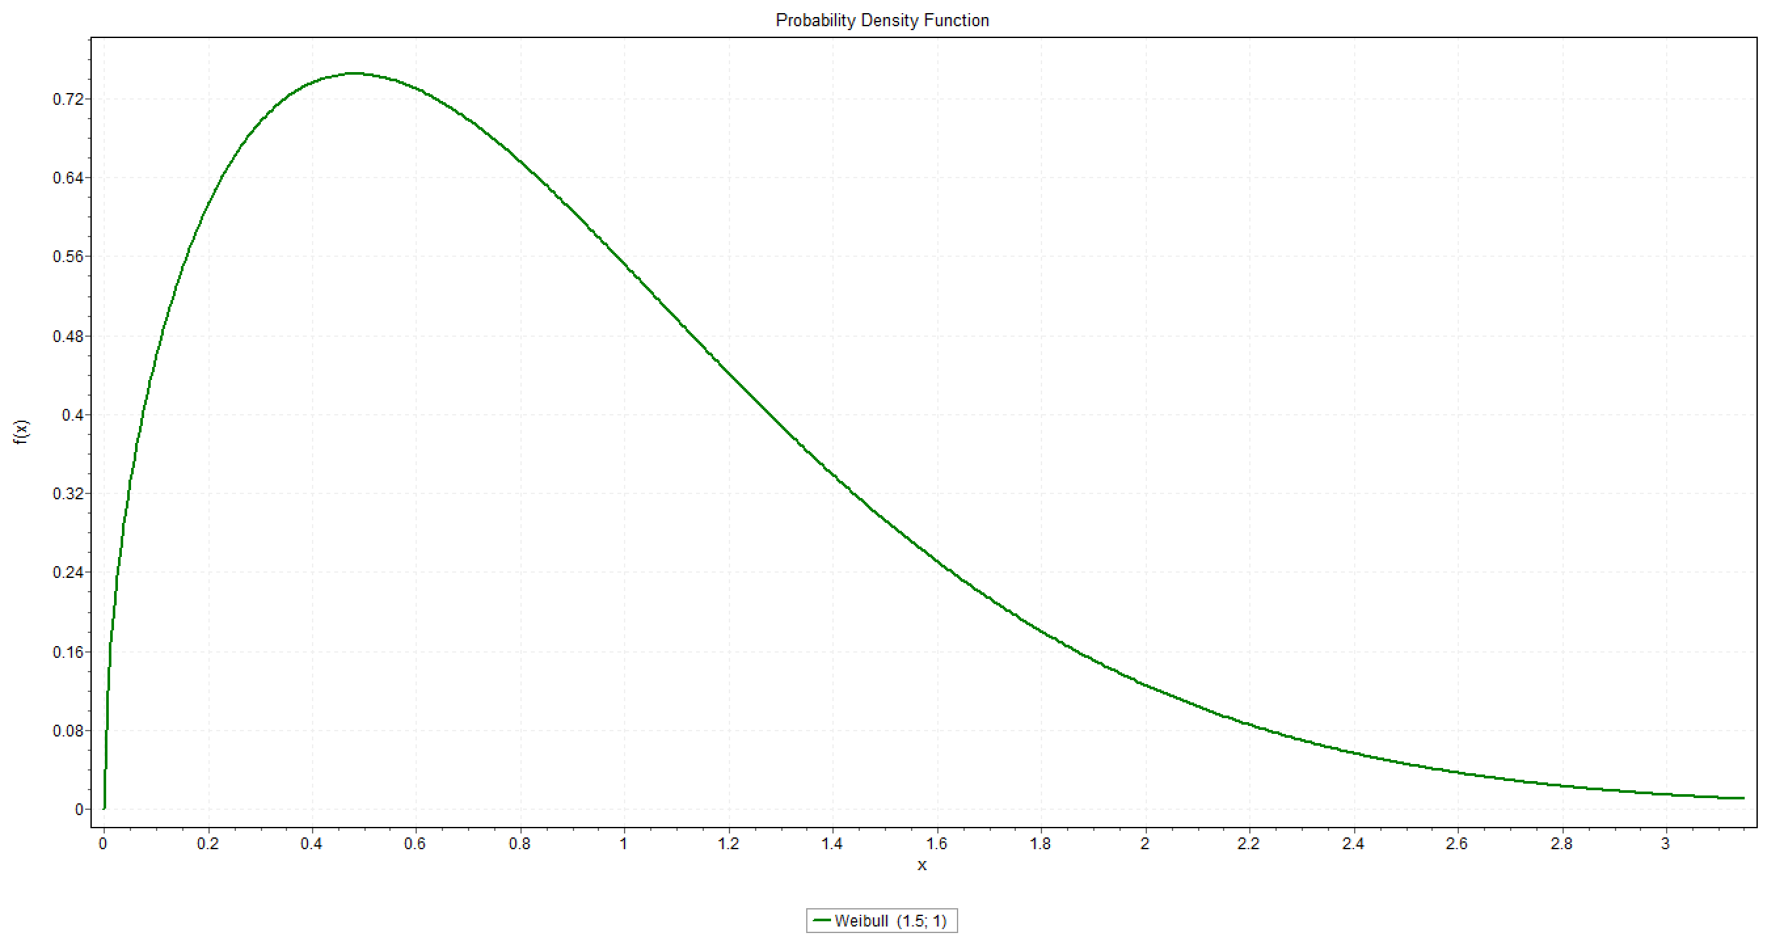

Slide 119
Decision Induced Uncertainty
Every choice we make changes the outcome
Planned / Due Date
Actual Date
Staff
Dev Cost
Cost of Delay
July
August
September
October
November
December
Forecast Completion Date

Slide 120

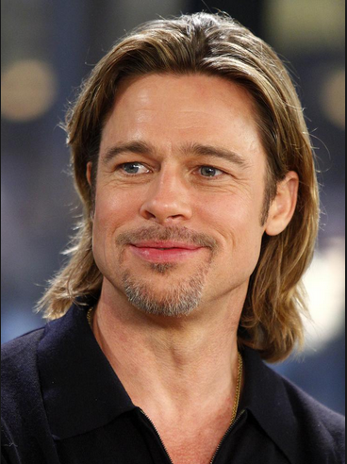
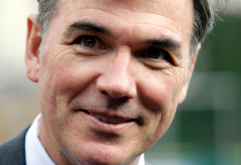

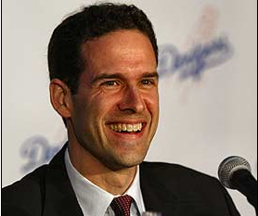

Brad Pitt
Billy Beane
Paul DePodesta
Jonah Hill (Playing fictional char.)

Slide 121


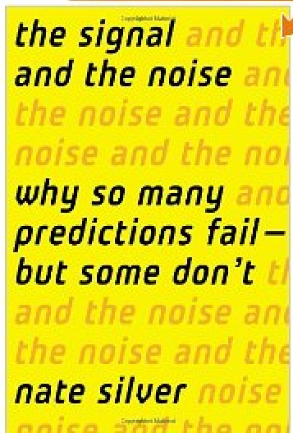
Earnshaw Cook
Percentage Baseball
(1964)
Alan Schwarz
The Numbers Game
(History of Sabremetrics)
The Signal and the Noise: Why So Many Predictions Fail — but Some Don't

Slide 122


Slide 123


Slide 124
Batting average
On-base percentage
a
b
High Cost to acquire
a
Low Cost to acquire
b
Don’t forget to mention often used as a tie-breaker
Wins

Slide 125
Latest Agile Framework
Multi-team impacts
a
b
Team coding performance?
New Agile methodology?
High Cost to fix
a
Escaped defects?
Dependency Mgmt?
Low Cost to fix
b
Delivery Impact

Slide 126
Baseball goal: Win more games
Software goal: Deliver more value
Predictably deliver
more value
to customers

Slide 127

Spurious Correlations: http://tylervigen.com/

Slide 128

Spurious Correlations: http://tylervigen.com/

Slide 129

Correlation != Causation
Criteria for causality
The cause precedes the effect in sequence
The cause and effect are empirically correlated and have a plausible interaction
The correlations is not spurious
(http://xkcd.com/552/ Creative Commons Attribution-NonCommercial 2.5 License)
Sources: Kan,2003 pp80 and Babbie, 1986

